Slide 1

Crosswalk from Cancer Registry to OMOP Oncology Module
Rimma Belenkaya

Slide 2
Outline
ETL of Diagnoses
ETL of Diagnostic Modifiers
Value as concept
Value as number
Derivation of disease Episodes
First occurrence

Slide 3
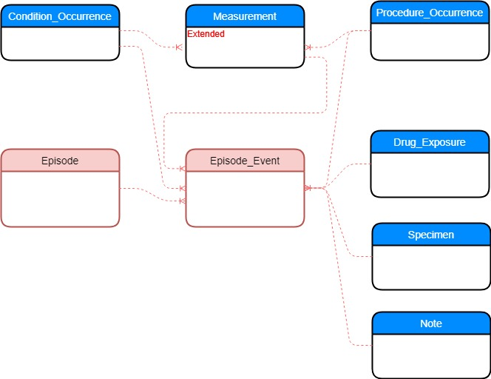
Oncology Model in OMOP CDM
Diagnosis,
pre-coordinated concept representing histology and topography
Modifier representing diagnostic and treatment features
Underlying events
Disease and Treatment
Episodes
Connection between
Episode and
Underlying events

Slide 4
Cancer Registry Patient Record Sample
Field# | NAACCR Item # | NAACCR Item Name | Value Code | Value Description
1 | 20 | Patient ID Number | 123456
2 | 400 | Primary Site | C50.9 | Breast, NOS
3 | 522 | Histologic Type ICD-O-3 | 8010/3 | Carcinoma, NOS
4 | 390 | Date of Diagnosis | Jun-9-2019
5 | 410 | Laterality | 1 | Right: origin of primary
6 | 440 | Grade | 4 | Grade IV
7 | 390 | Summary Stage 2018 | 2 | Regional by direct extension only

Slide 5
Source Table Structure
Field Name | NAACCR Item #
variable_id | NAACCR Item #
Patient_id | NAACCR Item Name
value | Value Code
histology_topography | Value Description
Recommendation to add histology_topography. Will
Simplify queries.

Slide 6
Source Data Sample
Patient_id | variable_id | value | histology_site
1 | 400 | C50.9 | 8010/3-C50.9
1 | 522 | 8010/3 | 8010/3-C50.9
1 | 390 | Jun-9-2019 | 8010/3-C50.9
1 | 410 | 1 | 8010/3-C50.9
1. Site and histology must be converted to the following format:
C50.9 and 8010/3
2. Adding histology_site field to the source data will simplify ETL

Slide 7
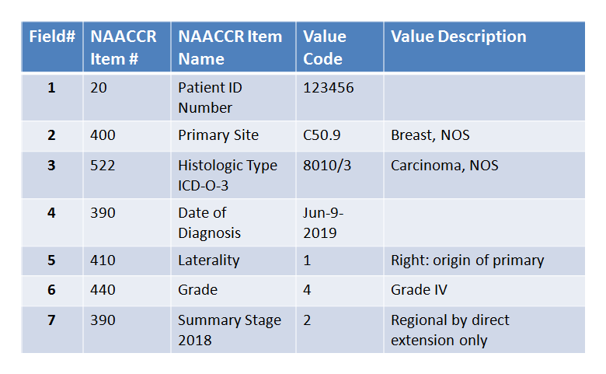
Crosswalk for Diagnosis
Cancer Registry patient record
CONDITION_OCCURRENCE record
CONCEPT: source concept for diagnosis
CONCEPT_RELATIONSHIP
CONCEPT: standard concept for diagnosis

Slide 8
SQL for ETL of Diagnosis
Insert into condition_occurrence
(person_id,
condition_start_date,
condition_start_date_time,
condition_concept_id,
condition_type_concept_id,
condition_source_value,
condition_source_concept_id)
select s1.patient_id,
s3.value,
s3.value,
c2.concept_id,
35941507,
s1.value || '-' || s2.value,
c1.concept_id
from data_source as s1
join data_source as s2
on s1.patient_id = s2.patient_id and s1.variable_id = '400' and s2.variable_id = '522'
join data_source as s3
on s1.patient_id = s3.patient_id and s3.variable_id = '390'
join concept as c2 on c2.standard_concept ='S'
join concept_relationship as ra on ra.concept_id_2 = c2.concept_id and ra.relationship_id = 'Maps to'
join concept as c1 on c1.concept_id = ra.concept_id_1
where c1.concept_code = s1.value || '-' || s2.value
and c1.vocabulary_id ='ICDO3'

Slide 9
Modifier for the First Occurrence
It is added to explicitly indicate condition_occurrence record corresponding to the first occurrence extracted from Cancer Registry
This modifier is not extracted from the data as other modifiers.

Slide 10
SQL for ETL of First Occurrence Modifier
Insert into measurement
(person_id,
measurement_datetime,
measurement_concept_id,
measurement_type_concept_id,
measurement_source_value,
modifier_of_event_id,
modifier_field_concept_id)
select s1.patient_id,
s3.value,
32528, -- First occurrence
35941507, -- Cancer registry
'First occurrence',
co.condition_occurrence_id,
1147127
from data_source as s1
join data_source as s2
on s1.patient_id = s2.patient_id and s1.variable_id = '400' and s2.variable_id = '522'
join data_source as s3
on s1.patient_id = s3.patient_id and s3.variable_id = '390'
join condition_occurrence as co on s1.patient_id = co.person_id and s3.value=co.condition_start_datetime and
and co.concept_code = s1.value || '-' || s2.value

Slide 11
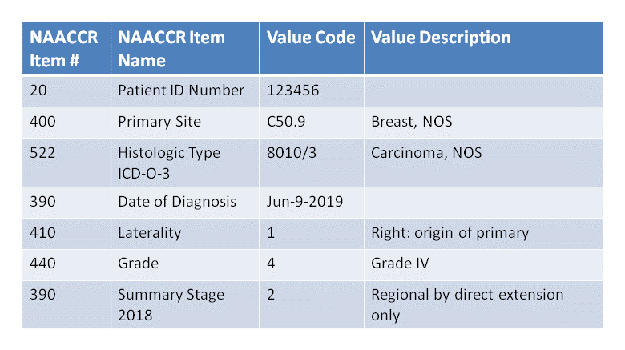
Crosswalk for Diagnostic Modifiers: value as concept
Cancer Registry patient record
CONDITION_OCCURRENCE record
CONCEPT: source concept for diagnosis
CONCEPT_RELATIONSHIP
CONCEPT_RELATIONSHIP
CONCEPT: concept for diagnostic schema
Measurement record
CONCEPT: standard concept for value
CONCEPT_RELATIONSHIP
CONCEPT_RELATIONSHIP
CONCEPT: standard concept for laterality
CONCEPT: standard concept for date

Slide 12
SQL for ETL of Diagnostic Modifier: value as concept
Insert into measurement
(person_id,
measurement_datetime,
measurement_concept_id,
value_as_concept_id,
measurement_type_concept_id,
measurement_source_value,
measurement_concept_id,
value_source_value,
modifier_of_event_id,
modifier_field_concept_id)

Slide 13
SQL for ETL of Diagnostic Modifier: value as concept
select s.patient_id
, sd.value as measurement_date
, c2.concept_id as measurement_concept_id
, c3.concept_id as value_as_concept_id
, 35941507 -- Cancer registry
, c2.concept_code as measurement_source_value
, c2.concept_id as measurement_source_concept_id
, c3.concept_code as value_source_value
FROM data_source AS s
-- Getting schema
JOIN concept d
ON d.vocabulary_id = 'ICDO3' AND d.concept_code = s.histology || '-' || s.site
JOIN concept_relationship cr1
ON d.concept_id = cr1.concept_id_1 AND cr1.relationship_id = 'Variable to Schema'
JOIN concept AS c1
ON cr1.concept_id_2 = c1.concept_id AND c1.vocabulary_id = 'NAACCR'
-- Getting variable
JOIN concept AS c2
ON c2.vocabulary_id = 'NAACCR' AND (c2.concept_code = s.variable_id OR c2.concept_code = c1.concept_code || '-' || s.variable_id)
-- Getting permissible value
JOIN concept AS c3
ON c3.vocabulary_id = 'NAACCR' AND (c3.concept_code = s.variable_id || '-' || s.value OR c3.concept_code = c1.concept_code || '-' || s.variable_id || '-' || s.value)
-- Getting date
join concept_relationship crd
on c2.concept_id = crd.concept_id_1 and crd.relationship_id = 'Variable has date'
join concept cd on crd.concept_id_2 = cd.concept_id
join data_source as sd
on s.patient_id = sd.patient_id and sd.variable_id = cd.concept_code
join condition_occurrence co
on co.person_id = s.patient_id
and co.condition_start_datetime = sd.value
and co.condition_concept_id = c2.concept_id
And co.condition_type_concept_id = 35941507

Slide 14
Derivation of First Occurrence Episode
CONDITION_OCCURRENCE record
EPISODE record
EPISODE_EVENT record

Slide 15
SQL for derivation of First Occurrence episode
Insert into episode
(person_id,
episode_start_datetime,
episode_concept_id,
episode_object_concept_id,
episode_type_concept_id)
select co.person_id,
co.condition_start_datetime,
32528, -- First occurrence
co.condition_concept_id,
35941507 -- Cancer registry
From condition_occurrence as co
join measurement as m on co.condition_occurrence_id = m.modifier_of_event_id and m.modifier_concept_id = ‘condition_occurence.condition_occurrence_id’
and m.measurement_concept_id = 32528

Slide 16
SQL for derivation of First Occurrence episode
Insert into episode_event
(episode_id,
condition_occurrence_id,
episode_event_event_id,
episode_field_concept_id)
select co.person_id,
co.condition_start_datetime,
32528, -- First occurrence
co.condition_concept_id,
35941507 -- Cancer registry
From condition_occurrence as co
join episode as e on e.person_id = co.person_id
and e.episode_concept_id = 32528
and e.episode_type_concept_id = 35941507
join measurement as m on co.condition_occurrence_id = m.modifier_of_event_id and m.modifier_field_concept_id = ‘condition_occurrence.condition_occurrence_id’
and m.measurement_concept_id = 32528

